Slide 1

Lecture 3.2 – CUDA Parallelism Model
GPU Teaching Kit
Multidimensional Kernel Configuration

Slide 2
Objective
To understand multidimensional Grids
Multi-dimensional block and thread indices
Mapping block/thread indices to data indices
2

Slide 3
A Multi-Dimensional Grid Example
host
device
Grid 1
Block (0, 0)
Block (0, 1)
Kernel 1
Block (1, 0)
Block (1, 1)
Block (1,0)
Grid 2
(1,0,0)
(1,0,1)
(1,0,2)
(1,0,3)
Thread
(0,0,0)
Thread
(0,0,1)
Thread
(0,0,2)
Thread
(0,0,3)
Thread
(0,0,0)
Thread
(0,1,3)
Thread
(0,1,0)
Thread
(0,1,1)
Thread
(0,1,2)
3

Slide 4
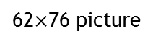
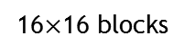

Slide 5
Row-Major Layout in C/C++
M
Row*Width+Col = 2*4+1 = 9
M₀
M₁
M₂
M₃
M₄
M₅
M₆
M₇
M₈
M₉
M₁₀
M₁₁
M₁₂
M₁₃
M₁₄
M₁₅
M
M_{0,0}
M_{0,1}
M_{0,2}
M_{0,3}
M_{1,0}
M_{1,1}
M_{1,2}
M_{1,3}
M_{2,0}
M_{2,1}
M_{2,2}
M_{2,3}
M_{3,0}
M_{3,1}
M_{3,2}
M_{3,3}
M_{0,0}
M_{0,1}
M_{0,2}
M_{0,3}
M_{1,0}
M_{1,1}
M_{1,2}
M_{1,3}
M_{2,0}
M_{2,1}
M_{2,2}
M_{2,3}
M_{3,0}
M_{3,1}
M_{3,2}
M_{3,3}

Slide 6
Source Code of a PictureKernel
__global__ void PictureKernel(float* d_Pin, float* d_Pout,
int height, int width)
{
// Calculate the row # of the d_Pin and d_Pout element
int Row = blockIdx.y*blockDim.y + threadIdx.y;
// Calculate the column # of the d_Pin and d_Pout element
int Col = blockIdx.x*blockDim.x + threadIdx.x;
// each thread computes one element of d_Pout if in range
if ((Row < height) && (Col < width)) {
d_Pout[Row*width+Col] = 2.0*d_Pin[Row*width+Col];
}
}
Scale every pixel value by 2.0

Slide 7
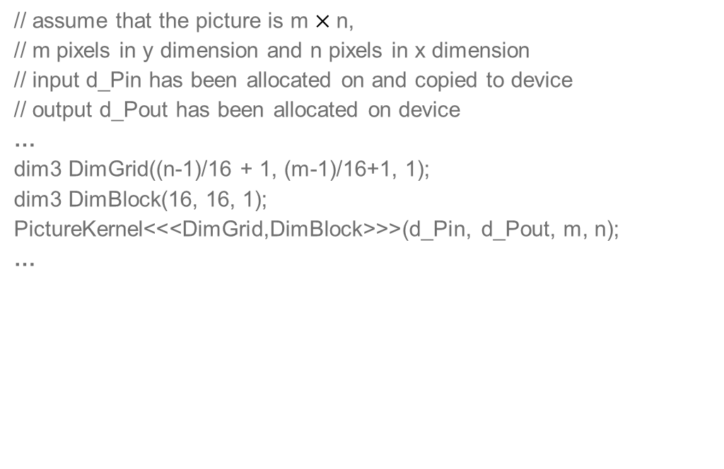
Host Code for Launching PictureKernel
// assume that the picture is m$×$n,
// m pixels in y dimension and n pixels in x dimension
// input d_Pin has been allocated on and copied to device
// output d_Pout has been allocated on device
…
dim3 DimGrid((n-1)/16 + 1, (m-1)/16+1, 1);
dim3 DimBlock(16, 16, 1);
PictureKernel<<<DimGrid,DimBlock>>>(d_Pin, d_Pout, m, n);
…

Slide 8
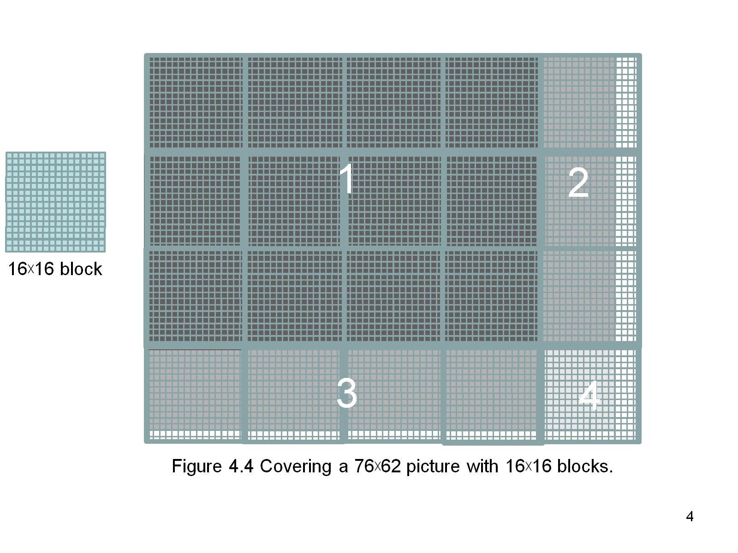
Covering a 62$×$76 Picture with 16$×$16 Blocks
Not all threads in a Block will follow the same control flow path.

Slide 9
The GPU Teaching Kit is licensed by NVIDIA and the University of Illinois under the Creative Commons Attribution-NonCommercial 4.0 International License.

